Slide 1
Input Dependence of Neural Subnetwork Gains
Tiffany Hamstreet
May 9, 2018

Slide 2
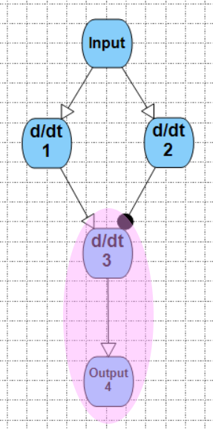
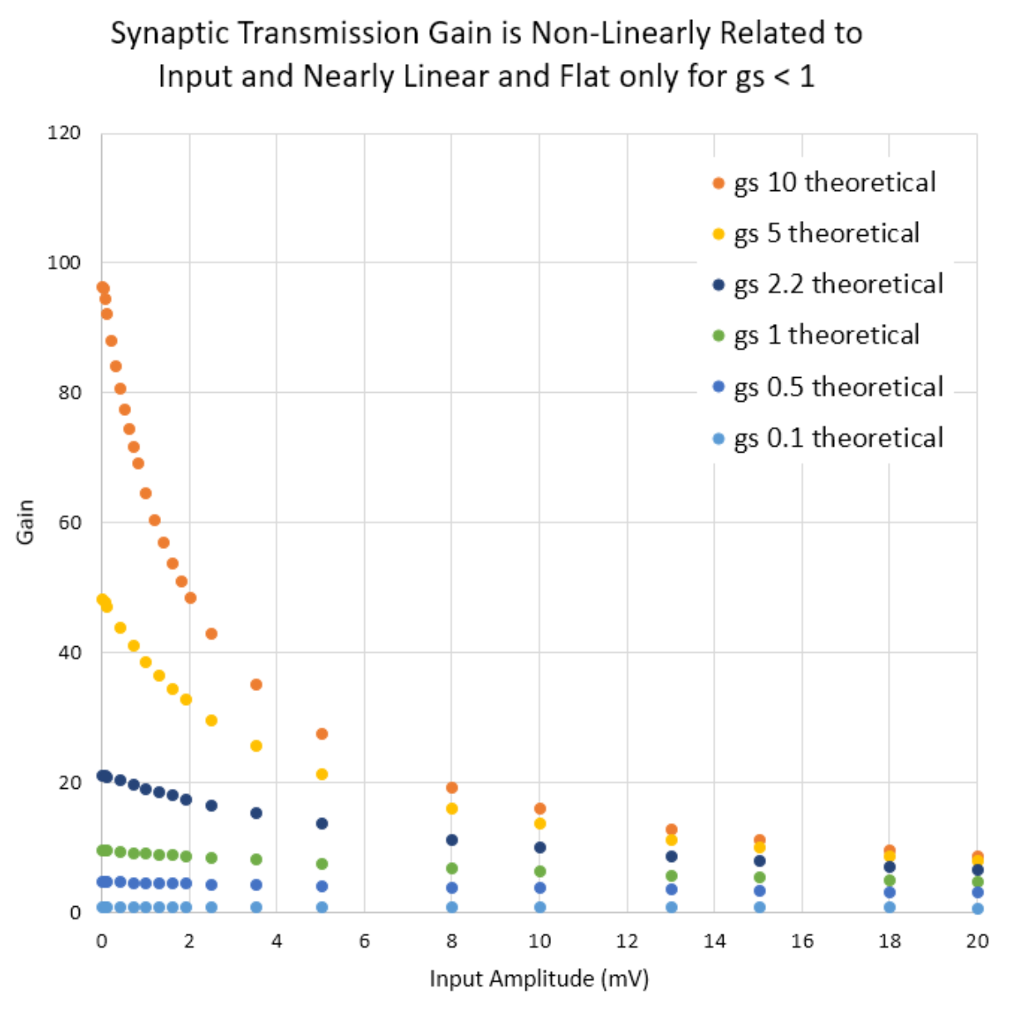
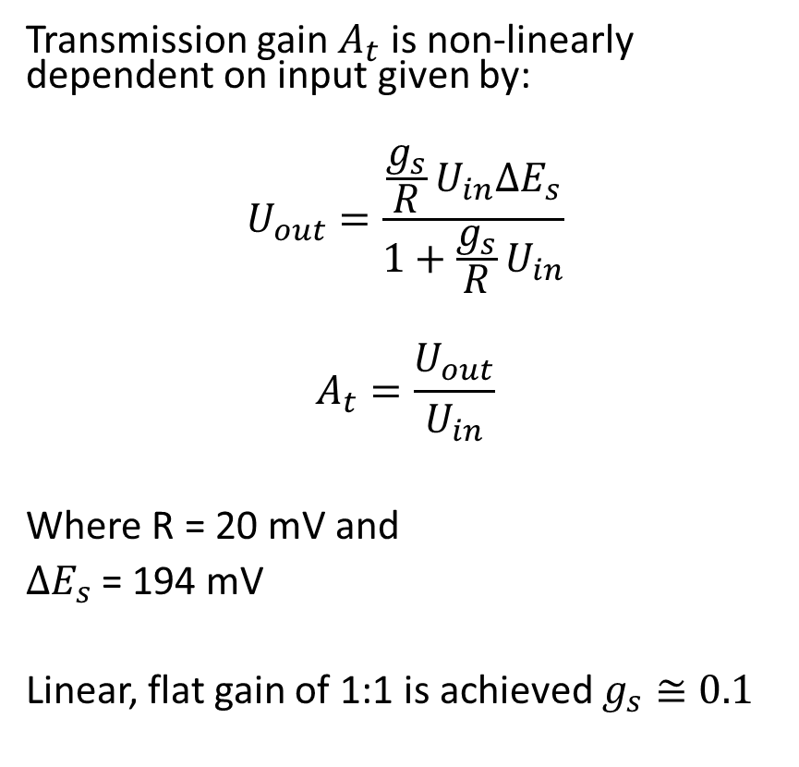
Transmission Synapse Gain
Transmission gain $A_{t}$ is non-linearly dependent on input given by:
$$U_{out}=\frac{\frac{g_{s}}{R}U_{in}{∆E}_{s}}{1+\frac{g_{s}}{R}U_{in}}$$
$$A_{t}=\frac{U_{out}}{U_{in}}$$
Where R = 20 mV and
${∆E}_{s}$= 194 mV
Linear, flat gain of 1:1 is achieved $g_{s}≅0.1$

Slide 3
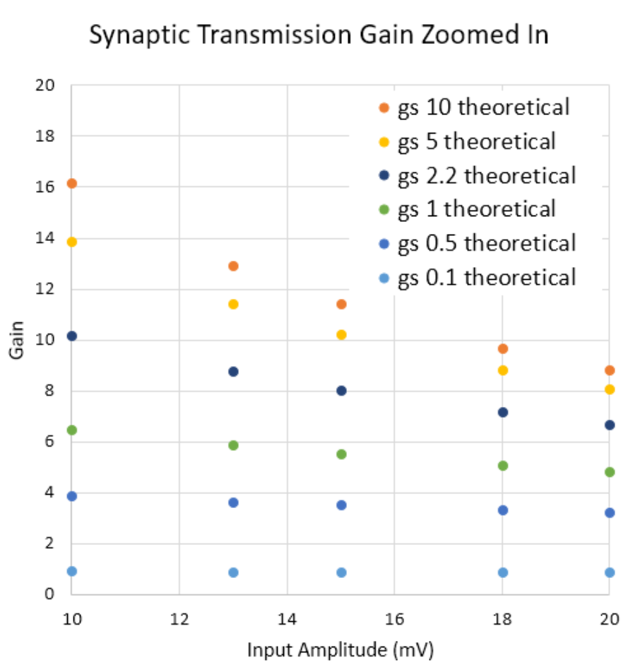

Transmission Synapse Gain
Approximating gains as linear above input amplitudes of 10mV yields the following slopes which may be used to predict gain ranges given a $g_{s}$:
gs | Gain at Input = 10 mV | Gain at Input = 20 mV | Approximate Slope (Gain Change/mV)
10 | 16.17 | 8.82 | 0.73
5 | 13.86 | 8.08 | 0.58
2.2 | 10.16 | 6.67 | 0.35
1 | 6.47 | 4.85 | 0.16
0.5 | 3.88 | 3.23 | 0.06
0.1 | 0.92 | 0.88 | 0.004

Slide 4
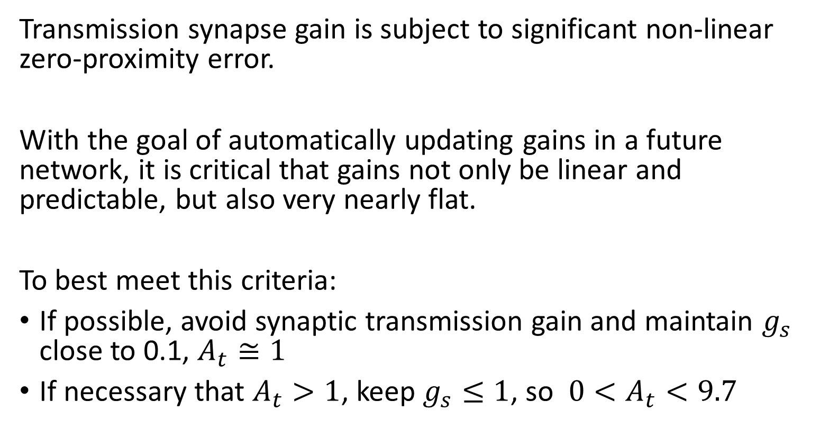
Transmission Synapse Conclusions
Transmission synapse gain is subject to significant non-linear zero-proximity error.
With the goal of automatically updating gains in a future network, it is critical that gains not only be linear and predictable, but also very nearly flat.
To best meet this criteria:
If possible, avoid synaptic transmission gain and maintain $g_{s}$ close to 0.1, $A_{t}≅1$
If necessary that $A_{t}>1$, keep $g_{s}≤1$, so ${0<A}_{t}<9.7$

Slide 5
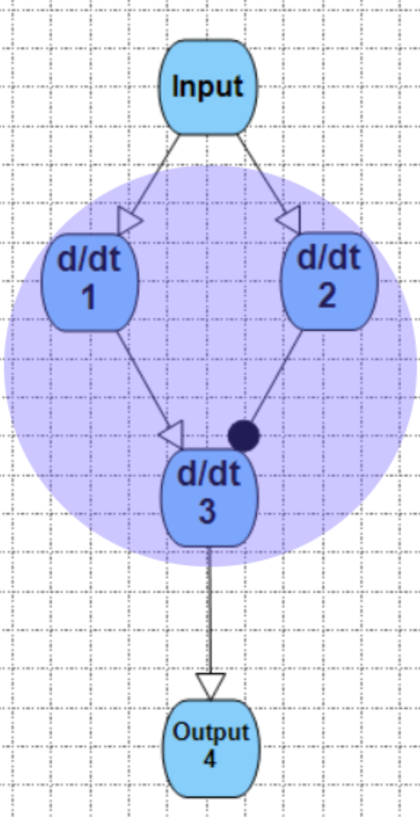
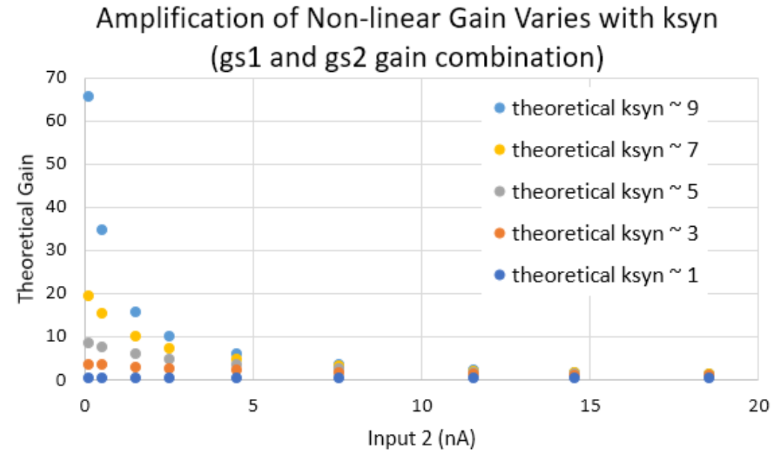
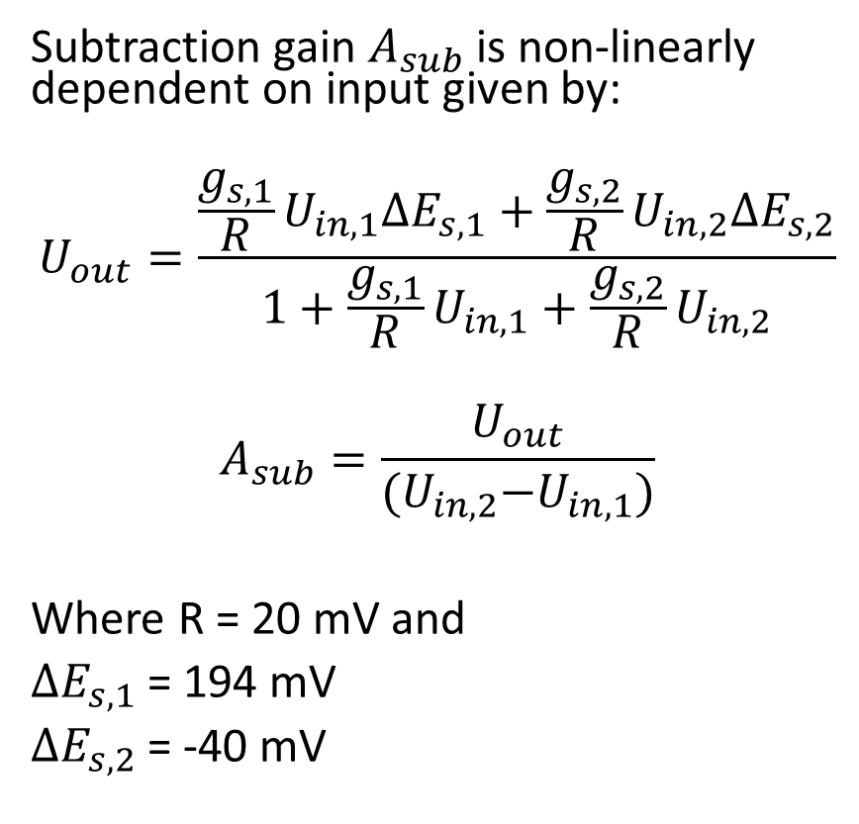
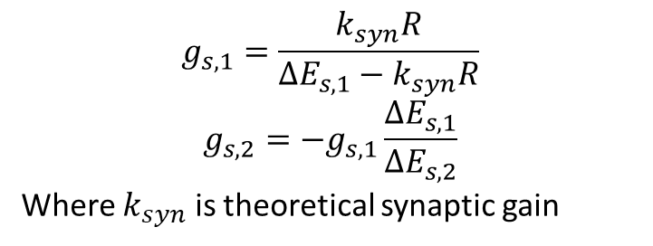
Subtraction Network Gain
Subtraction gain $A_{sub}$ is non-linearly dependent on input given by:
$$U_{out}=\frac{\frac{g_{s,1}}{R}U_{in,1}{∆E}_{s,1}+\frac{g_{s,2}}{R}U_{in,2}{∆E}_{s,2}}{1+\frac{g_{s,1}}{R}U_{in,1}+\frac{g_{s,2}}{R}U_{in,2}}$$
$$A_{sub}=\frac{U_{out}}{{(U}_{in,2}−U_{in,1})}$$
Where R = 20 mV and
${∆E}_{s,1}$= 194 mV
${∆E}_{s,2}$= -40 mV
$$g_{s,1}=\frac{k_{syn}R}{{∆E}_{s,1}−k_{syn}R}$$
$$g_{s,2}=−g_{s,1}\frac{{∆E}_{s,1}}{{∆E}_{s,2}}$$
Where $k_{syn}$ is theoretical synaptic gain

Slide 6
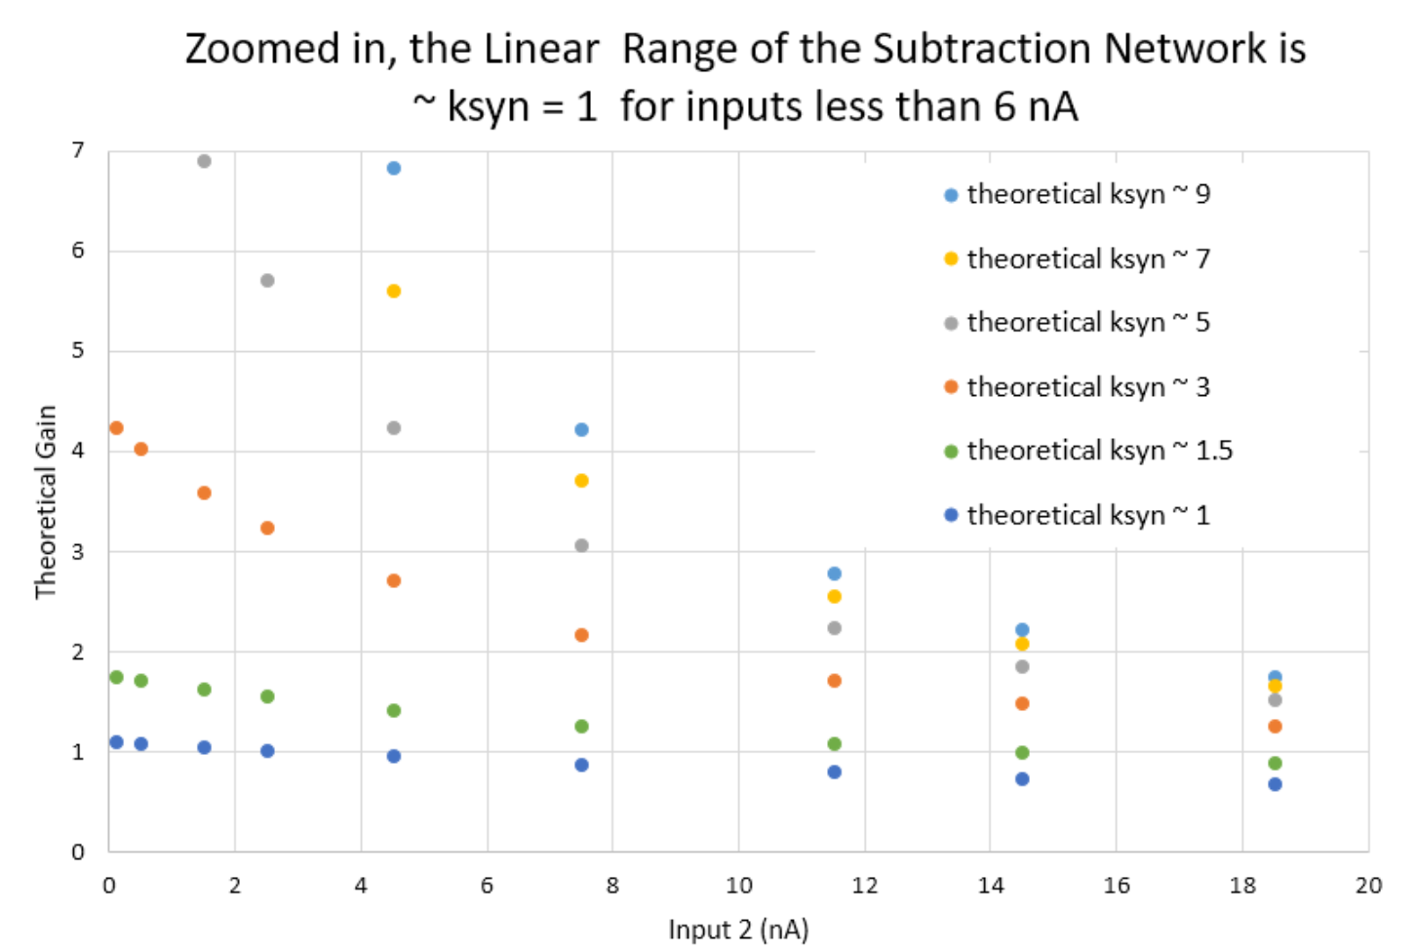
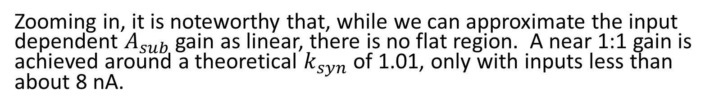
Subtraction Network Gain
Zooming in, it is noteworthy that, while we can approximate the input dependent $A_{sub}$ gain as linear, there is no flat region. A near 1:1 gain is achieved around a theoretical $k_{syn}$ of 1.01, only with inputs less than about 8 nA.

Slide 7
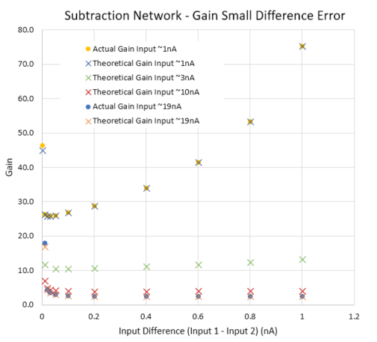
Subtraction Network Gain
Small Difference Error is present for input differences between 0 and 0.05 nA.
The non-linearities seen for inputs over 3 nA are attributed to the Zero Proximity Error seen in the previous slides, not Small-Difference Error.

Slide 8
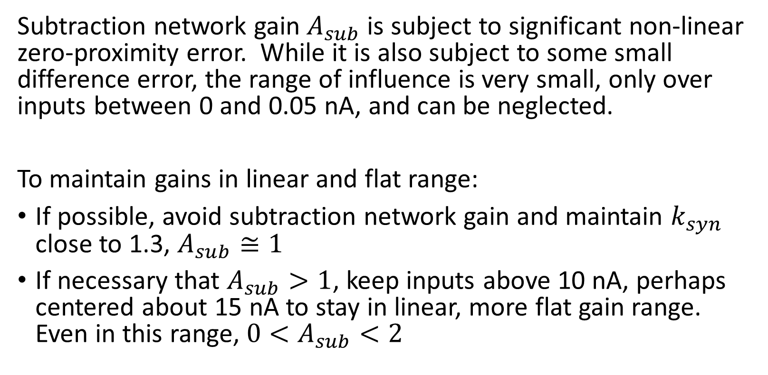
Subtraction Network Gain Conclusions
Subtraction network gain $A_{sub}$ is subject to significant non-linear zero-proximity error. While it is also subject to some small difference error, the range of influence is very small, only over inputs between 0 and 0.05 nA, and can be neglected.
To maintain gains in linear and flat range:
If possible, avoid subtraction network gain and maintain $k_{syn}$ close to 1.3, $A_{sub}≅1$
If necessary that $A_{sub}>1$, keep inputs above 10 nA, perhaps centered about 15 nA to stay in linear, more flat gain range. Even in this range, ${0<A}_{sub}<2$

Slide 9
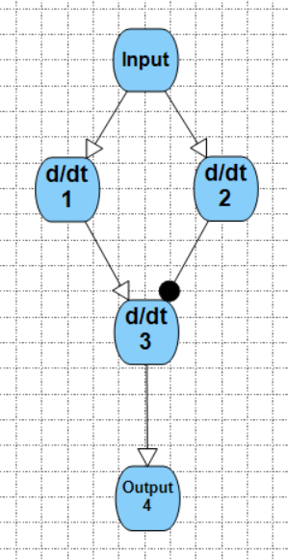
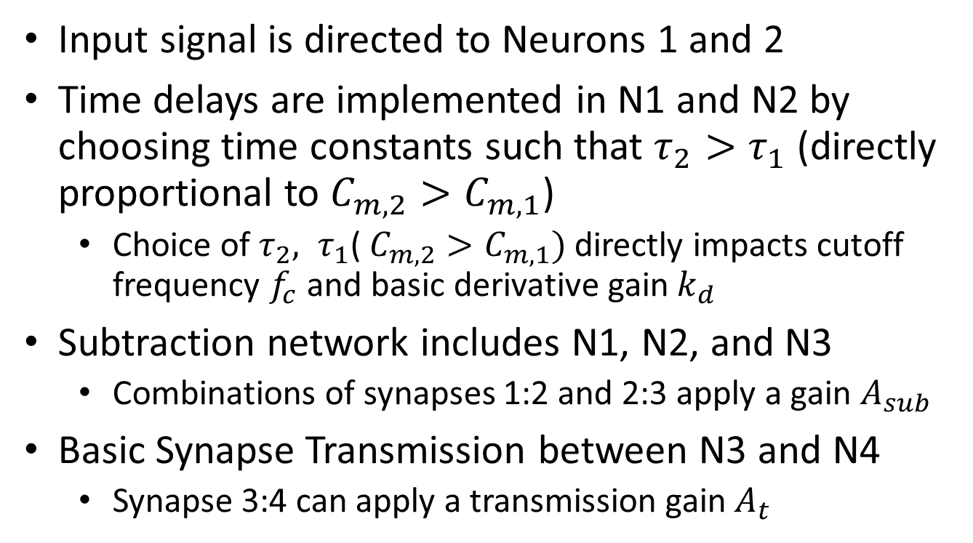
Derivative Network Components
Input signal is directed to Neurons 1 and 2
Time delays are implemented in N1 and N2 by choosing time constants such that $τ_{2}>τ_{1}$ (directly proportional to $C_{m,2}>C_{m,1}$)
Choice of $τ_{2}, τ_{1}$( $C_{m,2}>C_{m,1})$directly impacts cutoff frequency $f_{c}$ and basic derivative gain $k_{d}$
Subtraction network includes N1, N2, and N3
Combinations of synapses 1:2 and 2:3 apply a gain $A_{sub}$
Basic Synapse Transmission between N3 and N4
Synapse 3:4 can apply a transmission gain $A_{t}$

Slide 10
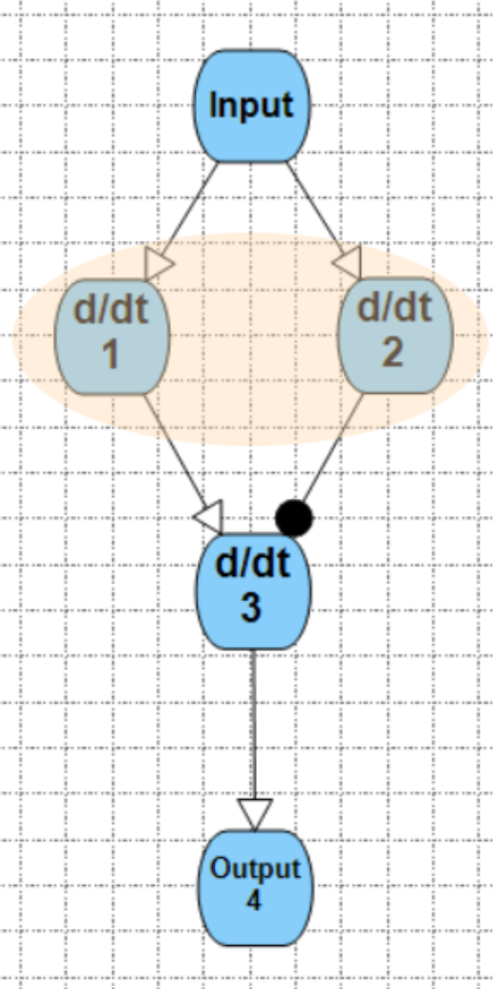
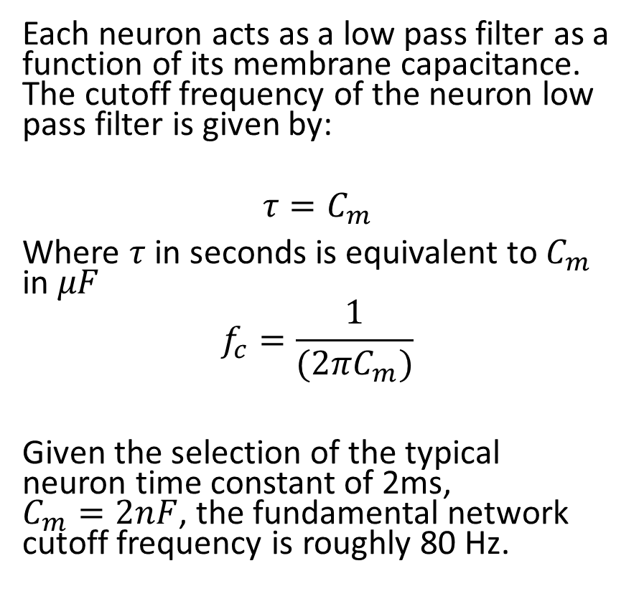
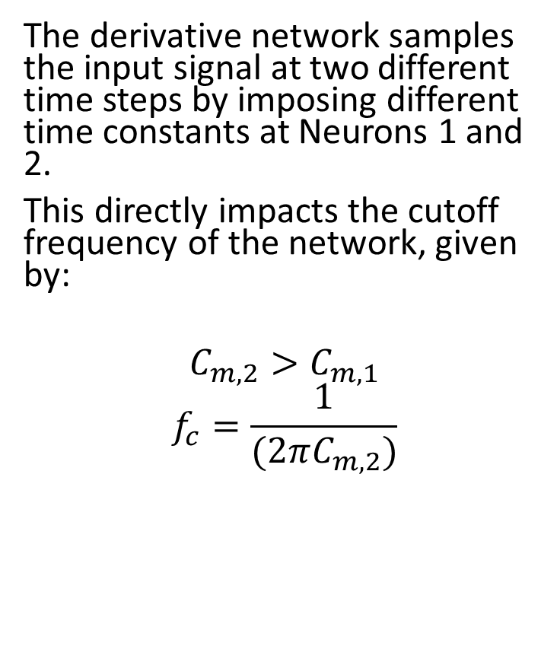
Time Constant Impact on Derivative Gain
Neuron as a Low Pass Filter
Each neuron acts as a low pass filter as a function of its membrane capacitance. The cutoff frequency of the neuron low pass filter is given by:
$$τ=C_{m}$$
Where $τ$ in seconds is equivalent to $C_{m}$ in $μF$
$$f_{c}=\frac{1}{(2πC_{m})}$$
Given the selection of the typical neuron time constant of 2ms, $C_{m}=2nF$, the fundamental network cutoff frequency is roughly 80 Hz.
The derivative network samples the input signal at two different time steps by imposing different time constants at Neurons 1 and 2.
This directly impacts the cutoff frequency of the network, given by:
$$C_{m,2}>C_{m,1}$$
$$f_{c}=\frac{1}{(2πC_{m,2})}$$

Slide 11
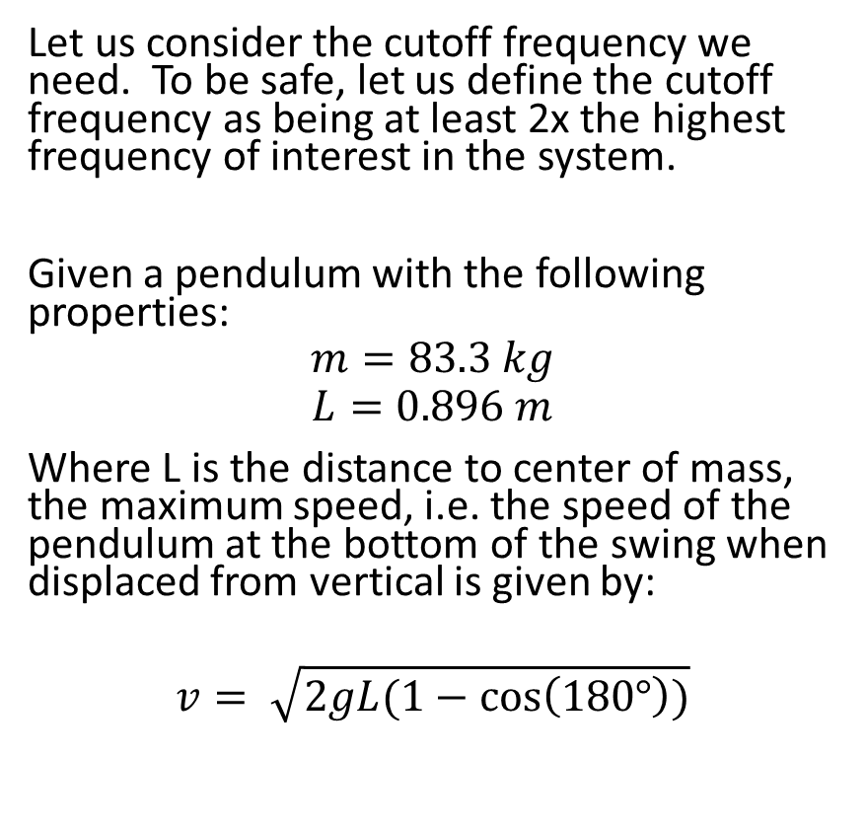
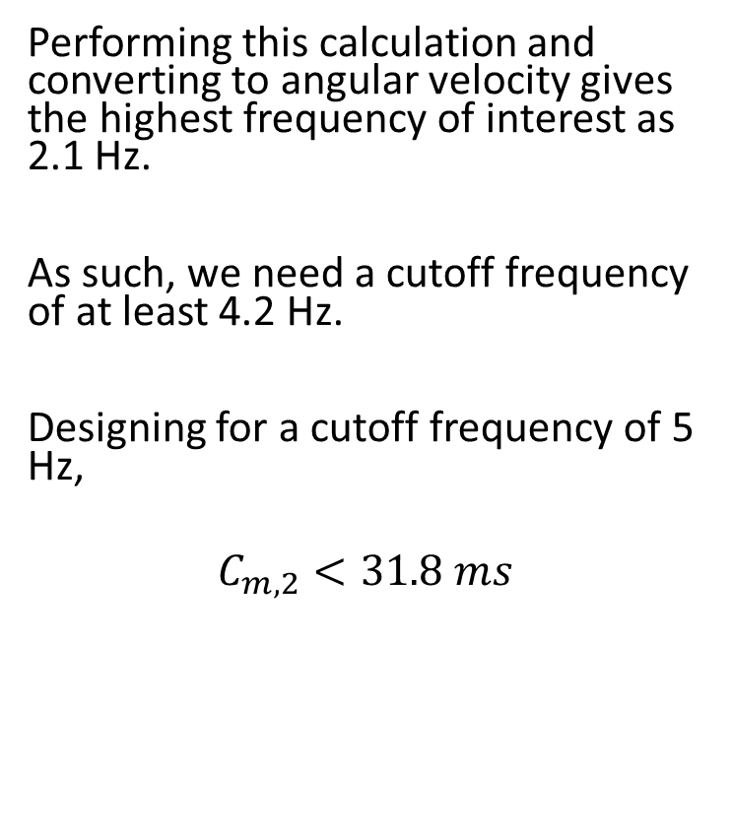
Time Constant Impact on Derivative Gain
Cutoff Frequency for Inverted Pendulum
Let us consider the cutoff frequency we need. To be safe, let us define the cutoff frequency as being at least 2x the highest frequency of interest in the system.
Given a pendulum with the following properties:
$$m=83.3 kg$$
$$L=0.896 m$$
Where L is the distance to center of mass, the maximum speed, i.e. the speed of the pendulum at the bottom of the swing when displaced from vertical is given by:
$$v= \sqrt{2gL(1−\cos\left(180°\right))}$$
Performing this calculation and converting to angular velocity gives the highest frequency of interest as 2.1 Hz.
As such, we need a cutoff frequency of at least 4.2 Hz.
Designing for a cutoff frequency of 5 Hz,
$$C_{m,2}<31.8 ms$$

Slide 12
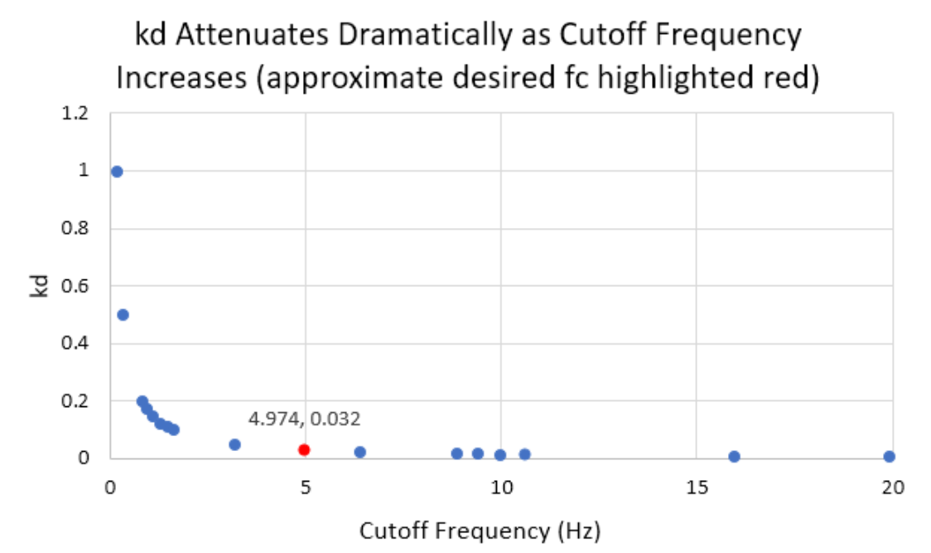
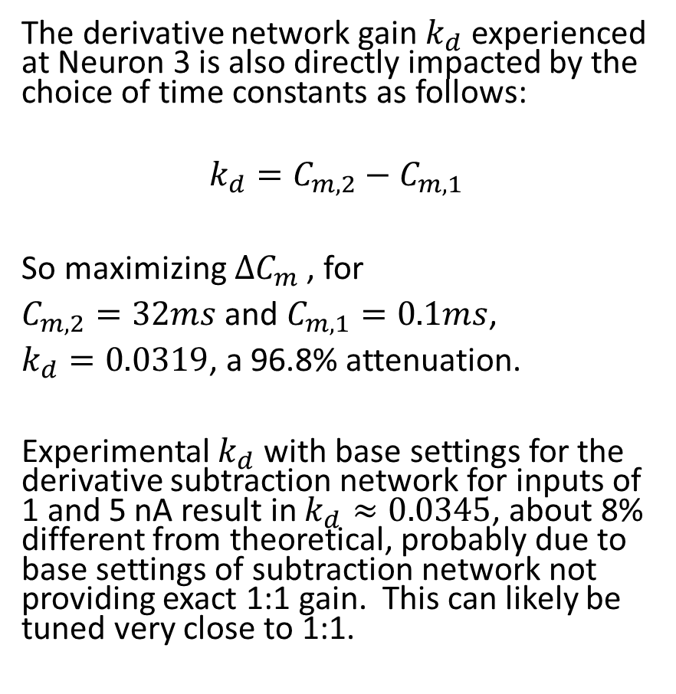
Time Constant Impact on Derivative Gain
The derivative network gain $k_{d}$ experienced at Neuron 3 is also directly impacted by the choice of time constants as follows:
$$k_{d}=C_{m,2}−C_{m,1}$$
So maximizing $∆C_{m}$ , for
$C_{m,2}=32ms$ and $C_{m,1}=0.1ms$,
$k_{d}=0.0319$, a 96.8% attenuation.
Experimental $k_{d}$ with base settings for the derivative subtraction network for inputs of 1 and 5 nA result in $k_{d}≈0.0345$, about 8% different from theoretical, probably due to base settings of subtraction network not providing exact 1:1 gain. This can likely be tuned very close to 1:1.

Slide 13
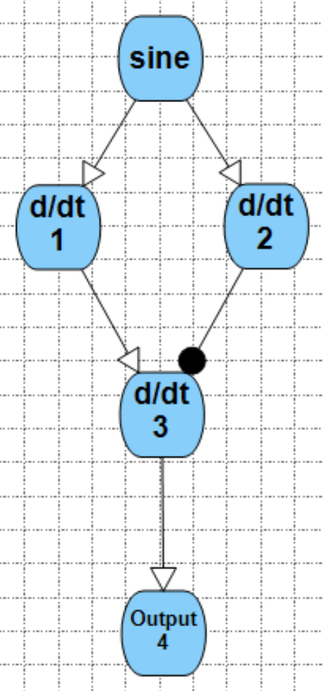
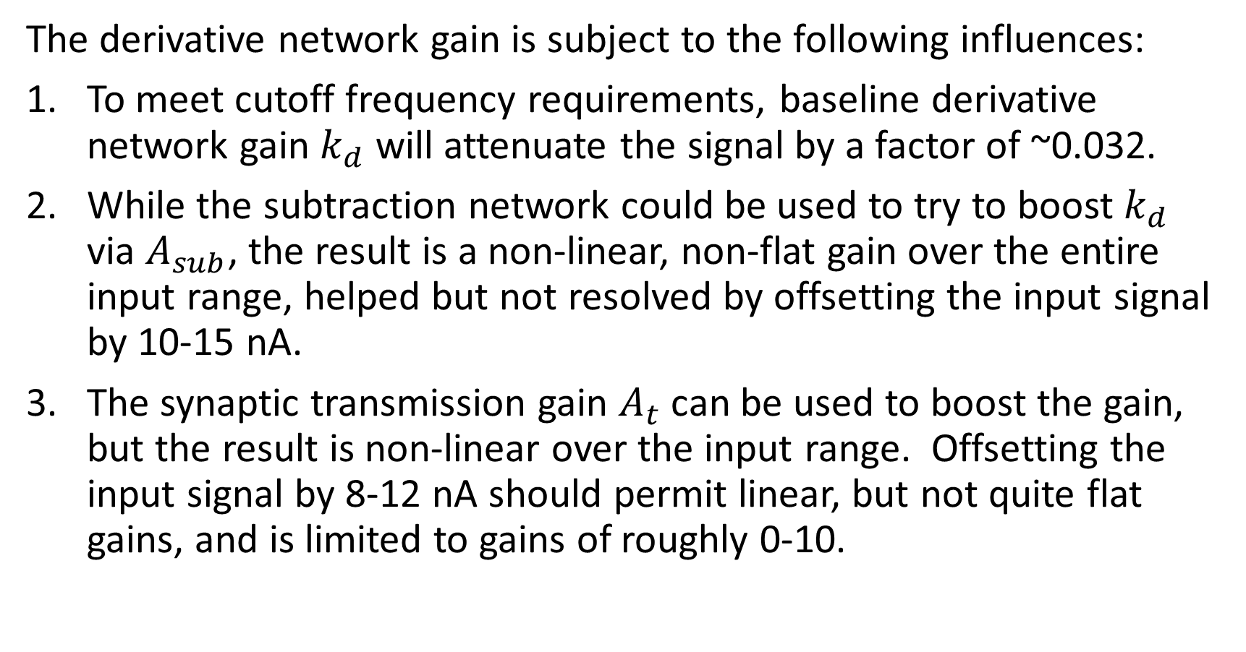
Derivative Summary
The derivative network gain is subject to the following influences:
To meet cutoff frequency requirements, baseline derivative network gain $k_{d}$ will attenuate the signal by a factor of ~0.032.
While the subtraction network could be used to try to boost $k_{d}$ via $A_{sub}$, the result is a non-linear, non-flat gain over the entire input range, helped but not resolved by offsetting the input signal by 10-15 nA.
The synaptic transmission gain $A_{t}$ can be used to boost the gain, but the result is non-linear over the input range. Offsetting the input signal by 8-12 nA should permit linear, but not quite flat gains, and is limited to gains of roughly 0-10.

Slide 14
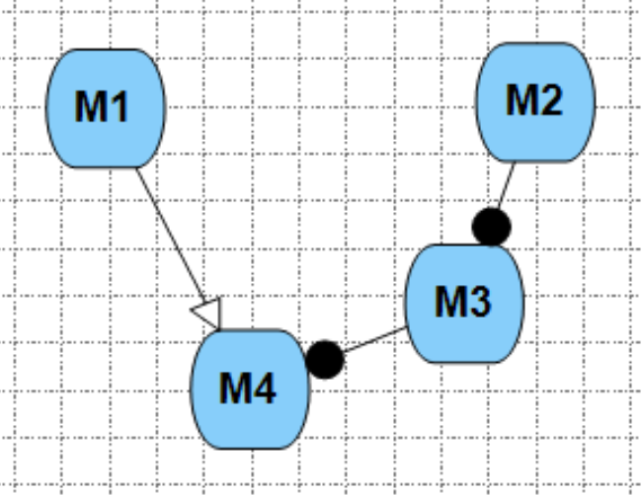
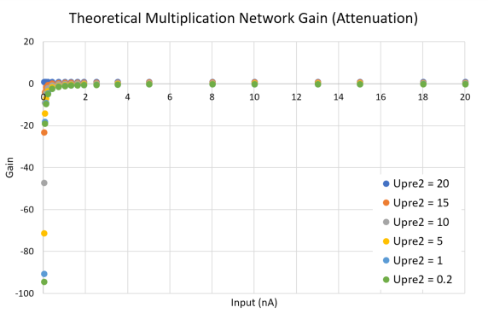
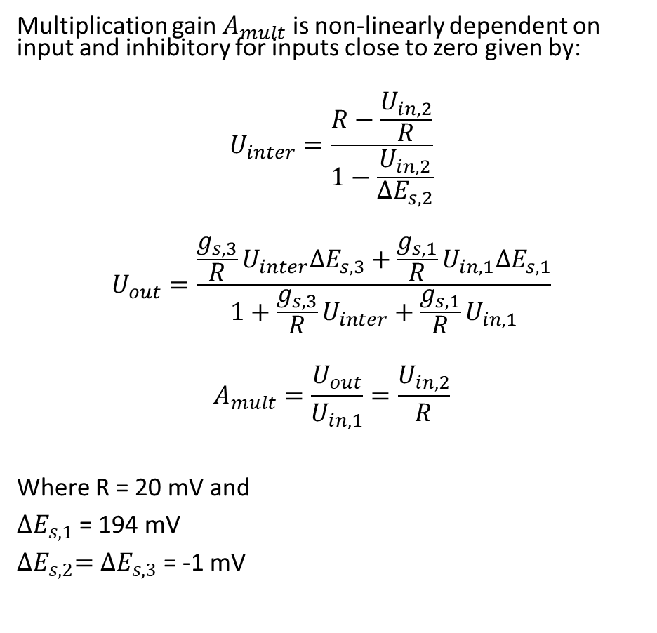
Multiplication Network Modulation Gains
Multiplication gain $A_{mult}$ is non-linearly dependent on input and inhibitory for inputs close to zero given by:
$$U_{inter}=\frac{R−\frac{U_{in,2}}{R}}{1−\frac{U_{in,2}}{{∆E}_{s,2}}}$$
$$U_{out}=\frac{\frac{g_{s,3}}{R}U_{inter}{∆E}_{s,3}+\frac{g_{s,1}}{R}U_{in,1}{∆E}_{s,1}}{1+\frac{g_{s,3}}{R}U_{inter}+\frac{g_{s,1}}{R}U_{in,1}}$$
$$A_{mult}=\frac{U_{out}}{U_{in,1}}=\frac{U_{in,2}}{R}$$
Where R = 20 mV and
${∆E}_{s,1}$= 194 mV
${∆E}_{s,2}={∆E}_{s,3}$ = -1 mV

Slide 15
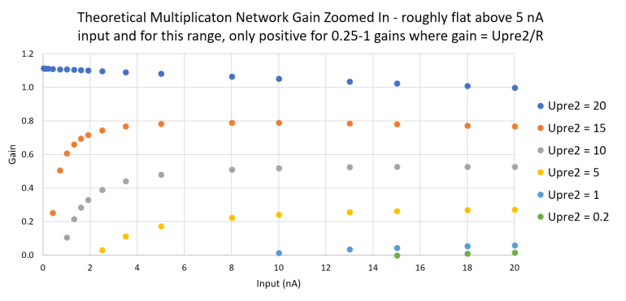
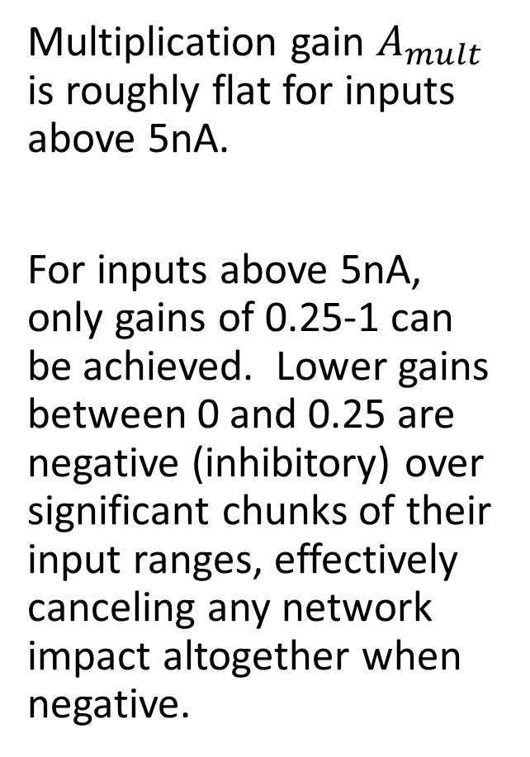
Multiplication Network Modulation Gains
Multiplication gain $A_{mult}$ is roughly flat for inputs above 5nA.
For inputs above 5nA, only gains of 0.25-1 can be achieved. Lower gains between 0 and 0.25 are negative (inhibitory) over significant chunks of their input ranges, effectively canceling any network impact altogether when negative.

